Slide 1
SOLAR WEATHER TEAM
Jack Harrison, Billy Harding, Laurence Dhonau, George Barber, Ben Robinson, Tim Lewis

Slide 2
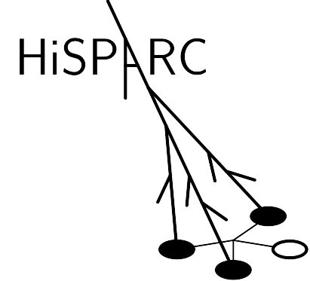
ACKNOWLEDGMENTS
Dr Michael McEllin FInstP FRAS CEng
Mr Steve Berry

Slide 3
PROJECT BACKGROUND
1
Cosmic Rays and Solar Wind

Slide 4
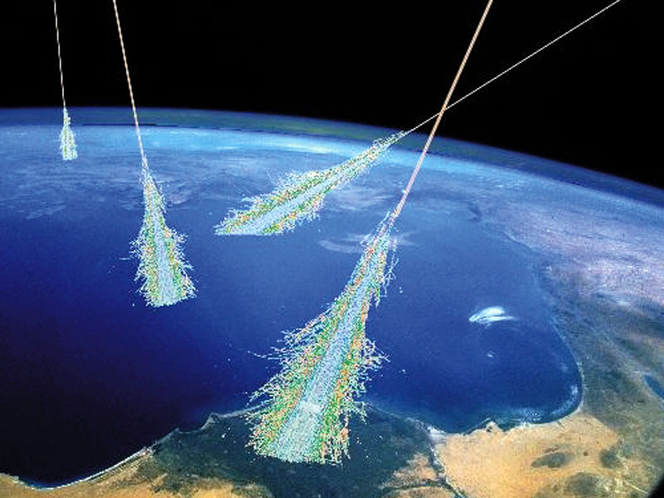
COSMIC RAYS
MAINLY PROTONS

Slide 5
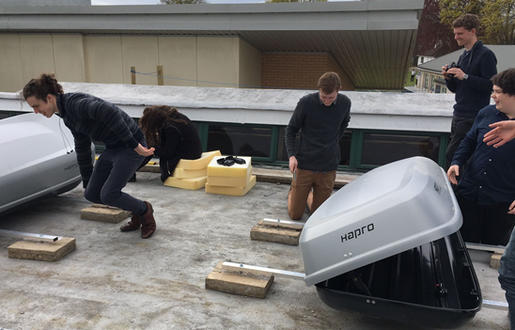
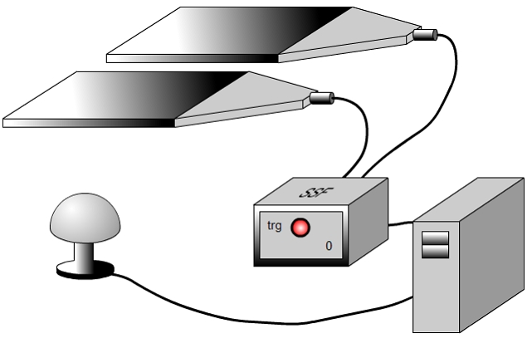
COSMIC RAYS

Slide 6
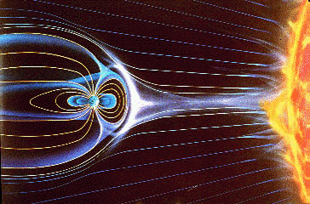
SOLAR WIND
MAINLY PROTONS

Slide 7
Solar wind speed and proton density vs cosmic ray count
Protons repel each other
Increase in solar wind speed results in decrease in cosmic ray count
Negative relationship

Slide 8
PROJECT EVENTS
2
Trips and Presentations

Slide 9
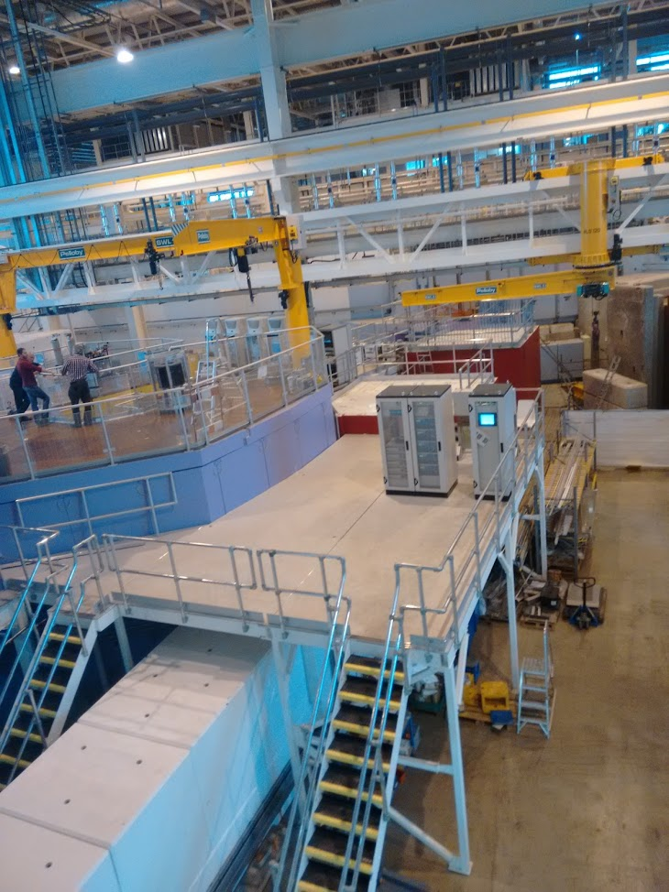
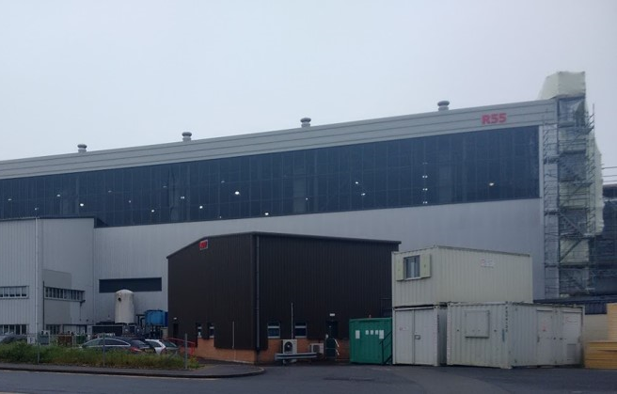
RUTHERFORD APPLETON LABORATORY

Slide 10
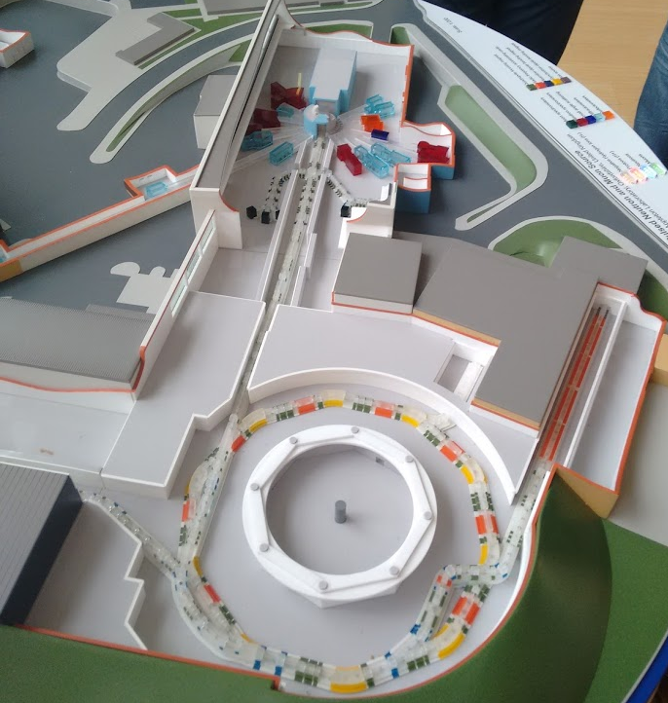
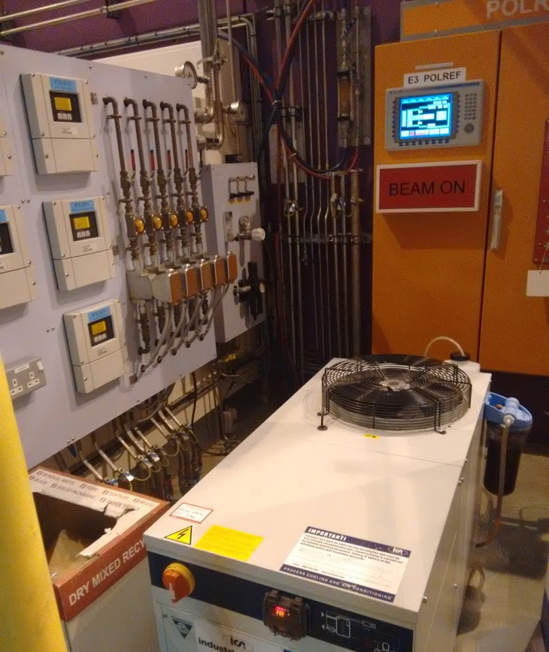
RUTHERFORD APPLETON LABORATORY

Slide 11
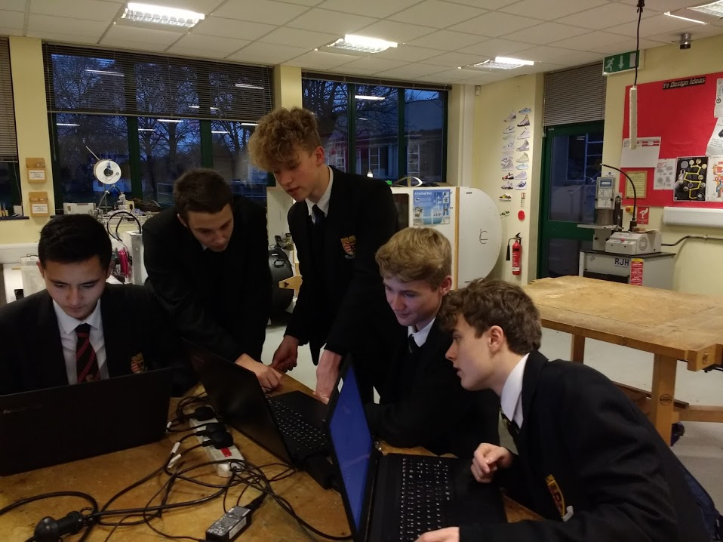
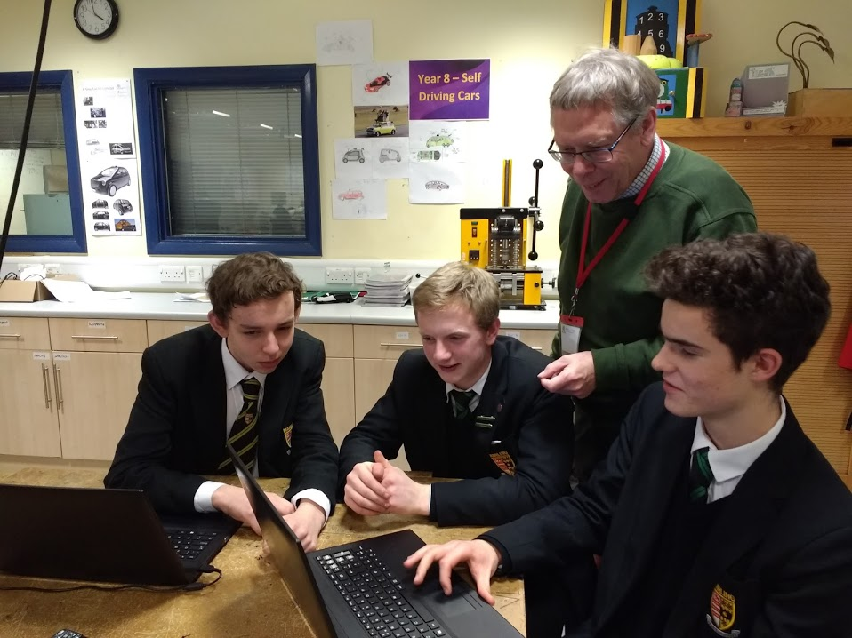
WEEKLY MEETINGS

Slide 12
THE ROYAL SOCIETY PRESENTATION

Slide 13
GOLD CREST AWARD
“the only nationally recognised accreditation scheme for project work in science, technology, engineering and mathematics (STEM) subjects”

Slide 14
RESEARCH
3
Gathering and Analysing Data

Slide 15
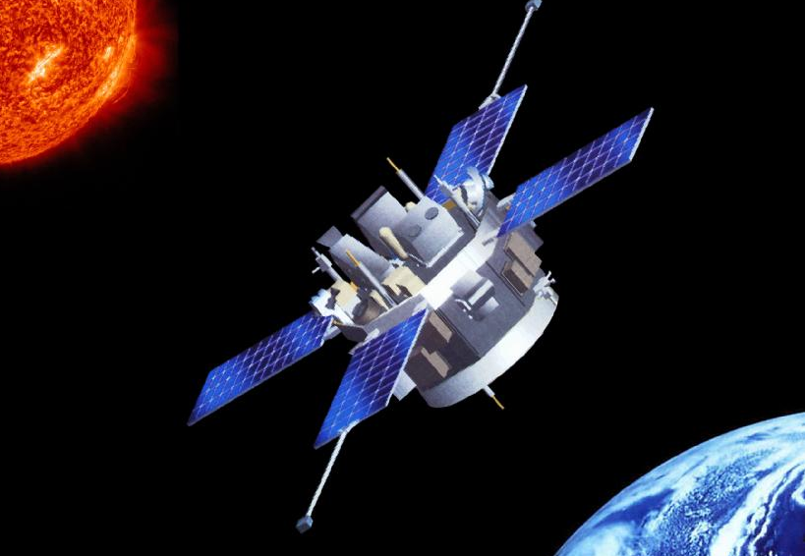
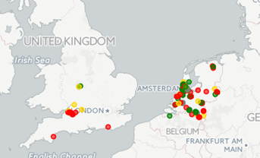
GATHERING DATA
Space Weather Prediction Centre, NOAA
Solar wind speed and proton density
HiSPARC detectors
Cosmic ray events

Slide 16
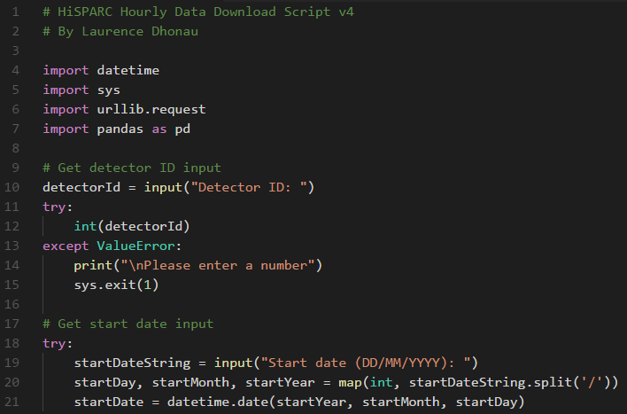
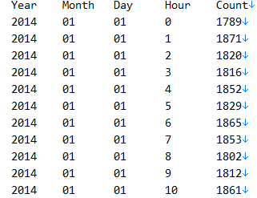
GATHERING DATA

Slide 17
ANALYSING DATA
STDEV CR Count | 90.741
STDEV Bulk Speed Count | 93.379
Covariance | 662.741
Correlation | 0.0782

Slide 18
ANALYSING DATA
Z Score
Correlation Coefficient
P-Value
Analysis via:
Calculation of a P-Value to determine likelihood of the null hypothesis being true.
Calculation of Pearson correlation coefficient.

Slide 19
ANALYSING DATA

Slide 20
PROJECT COMMUNICATION
4
Website and Research Paper

Slide 21
WEBSITE

Slide 22
WEBSITE
https://cosmicrayresearch.github.io

Slide 23
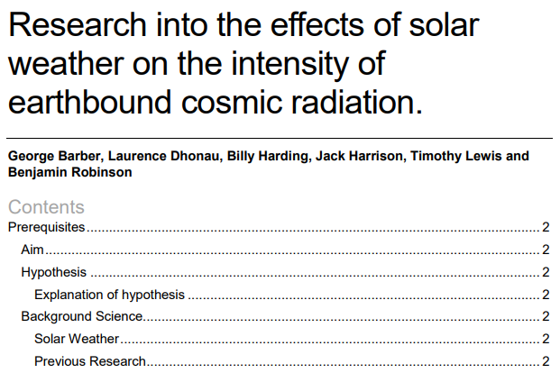
RESEARCH PAPER
Accessible via project website

Slide 24
CONCLUSIONS
5
Results and Deductions

Slide 25
CONCLUSIONS
We initially found no correlation between solar wind activity and cosmic ray count
Analysis of two much larger eight-year data sets identified a weak negative correlation, which matches accepted theory
However, correlation does not imply causation. In the future, the team could explore the effects of additional factors (e.g. weather) to confirm increased solar wind activity causes reduced cosmic ray count

Slide 26
CONCLUSIONS

Slide 27
THANK YOU
Any questions?
https://cosmicrayresearch.github.io
Presentation template from SlidesCarnival under Creative Commons Attribution license

